Slide 1



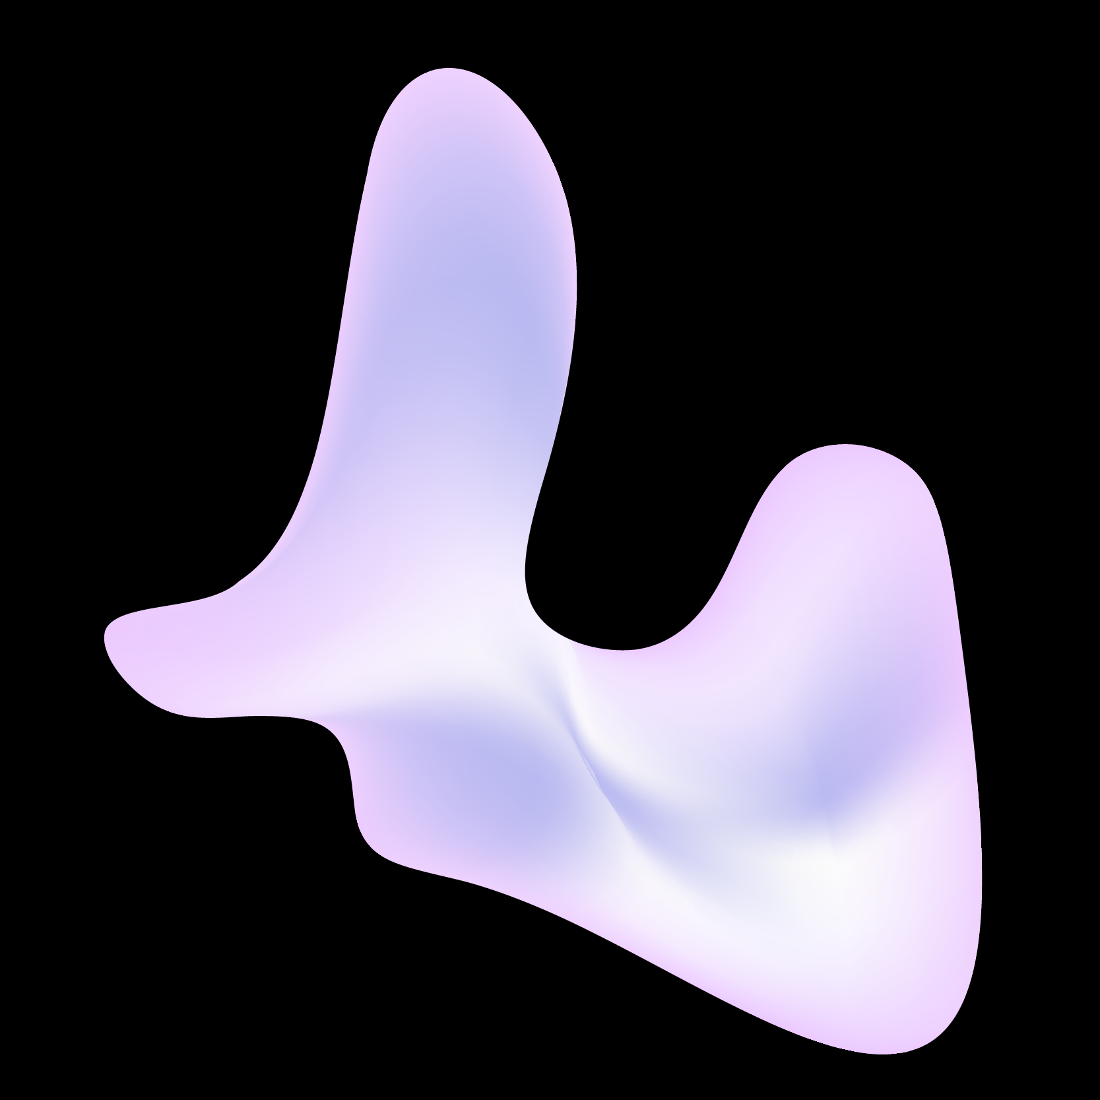
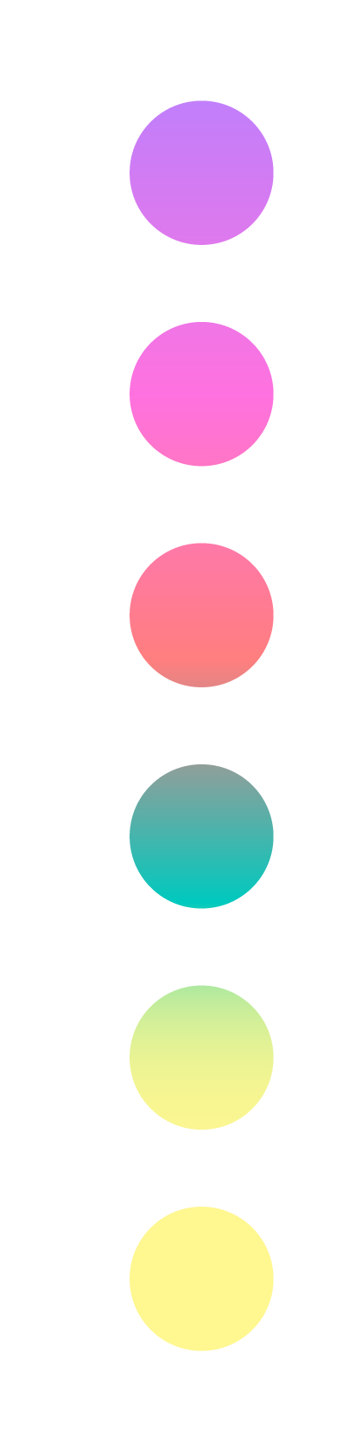
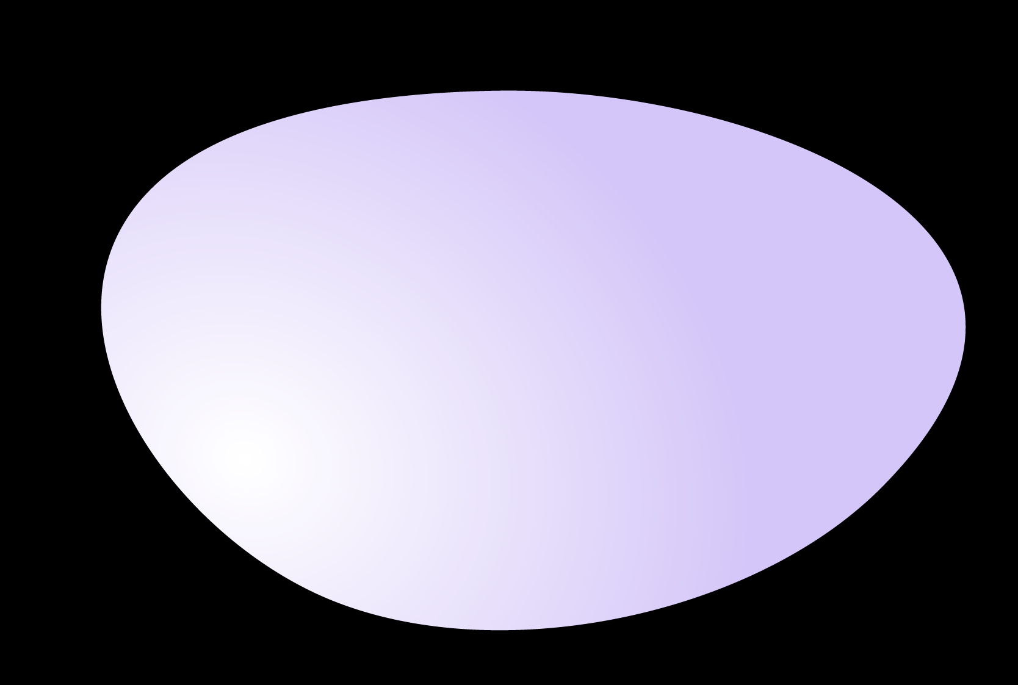
Welcome to Section!
Week 5

Slide 2

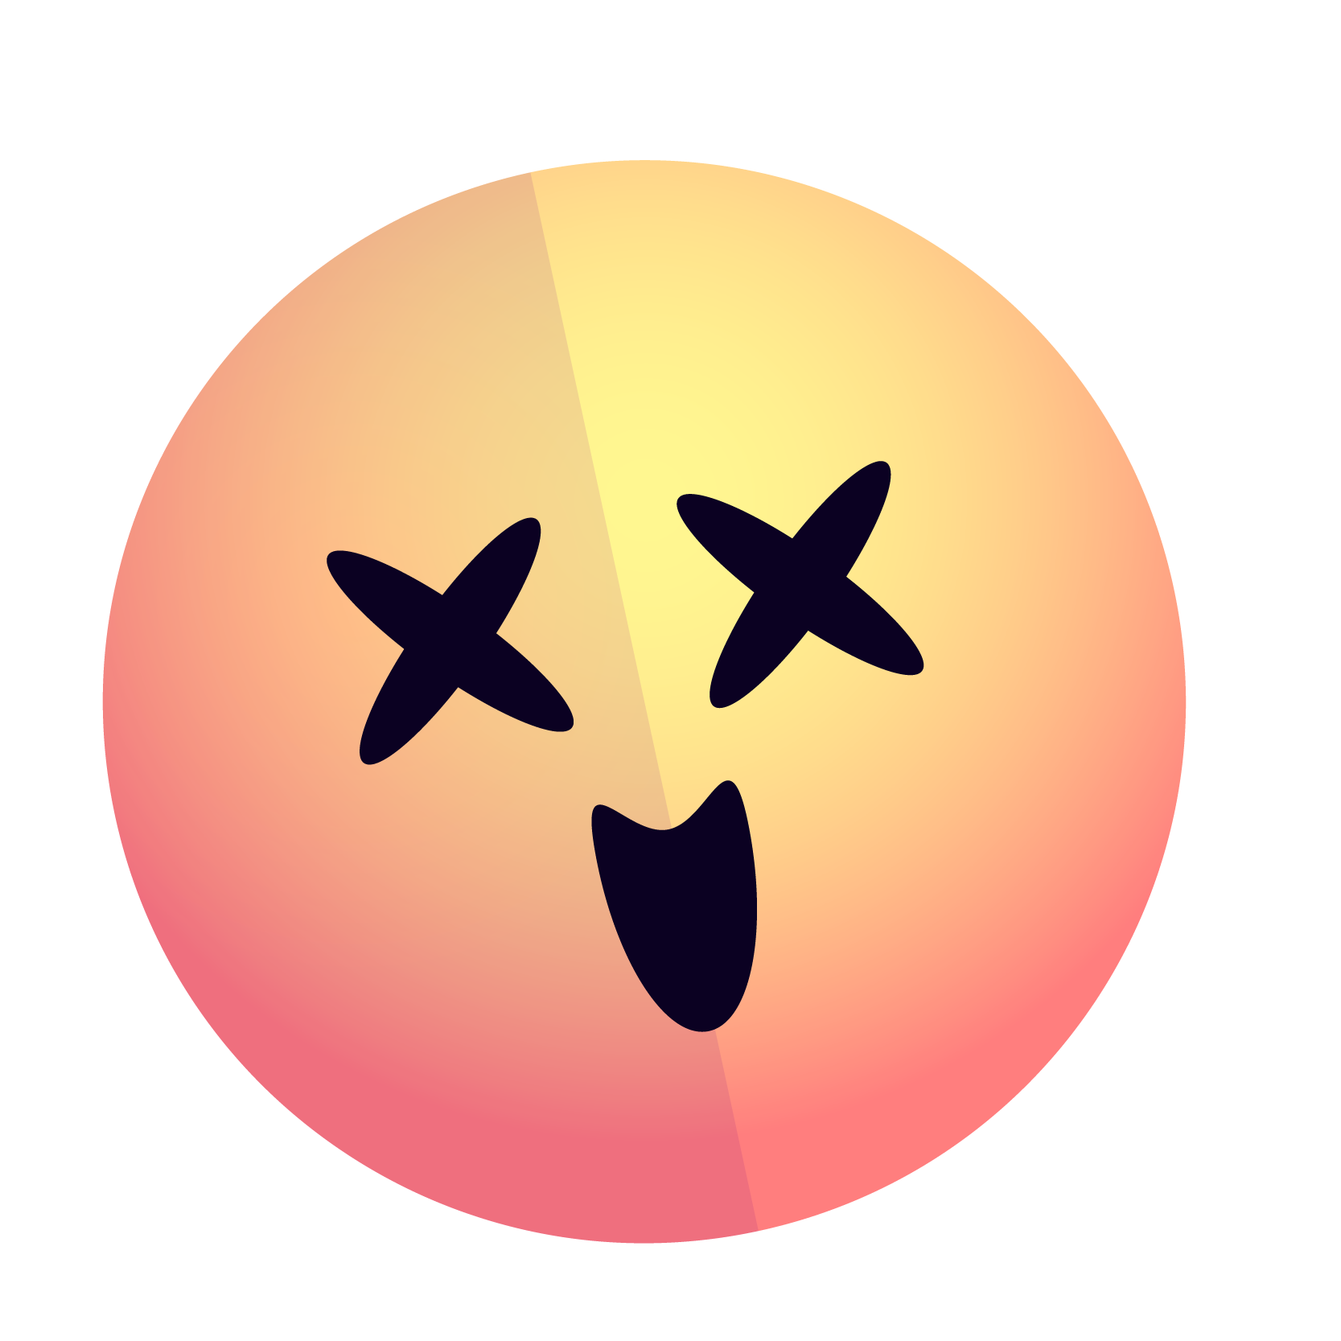

Agenda
1.
2.
3.
Check-in
Recap
Section Problem: Random Circles
Notes:
For today’s agenda, we will of course have our check-in. We do have a decent amount of recap since the materials this week were fairly dense. Lastly, we only have one section problem to solve with some optional extensions.

Slide 3
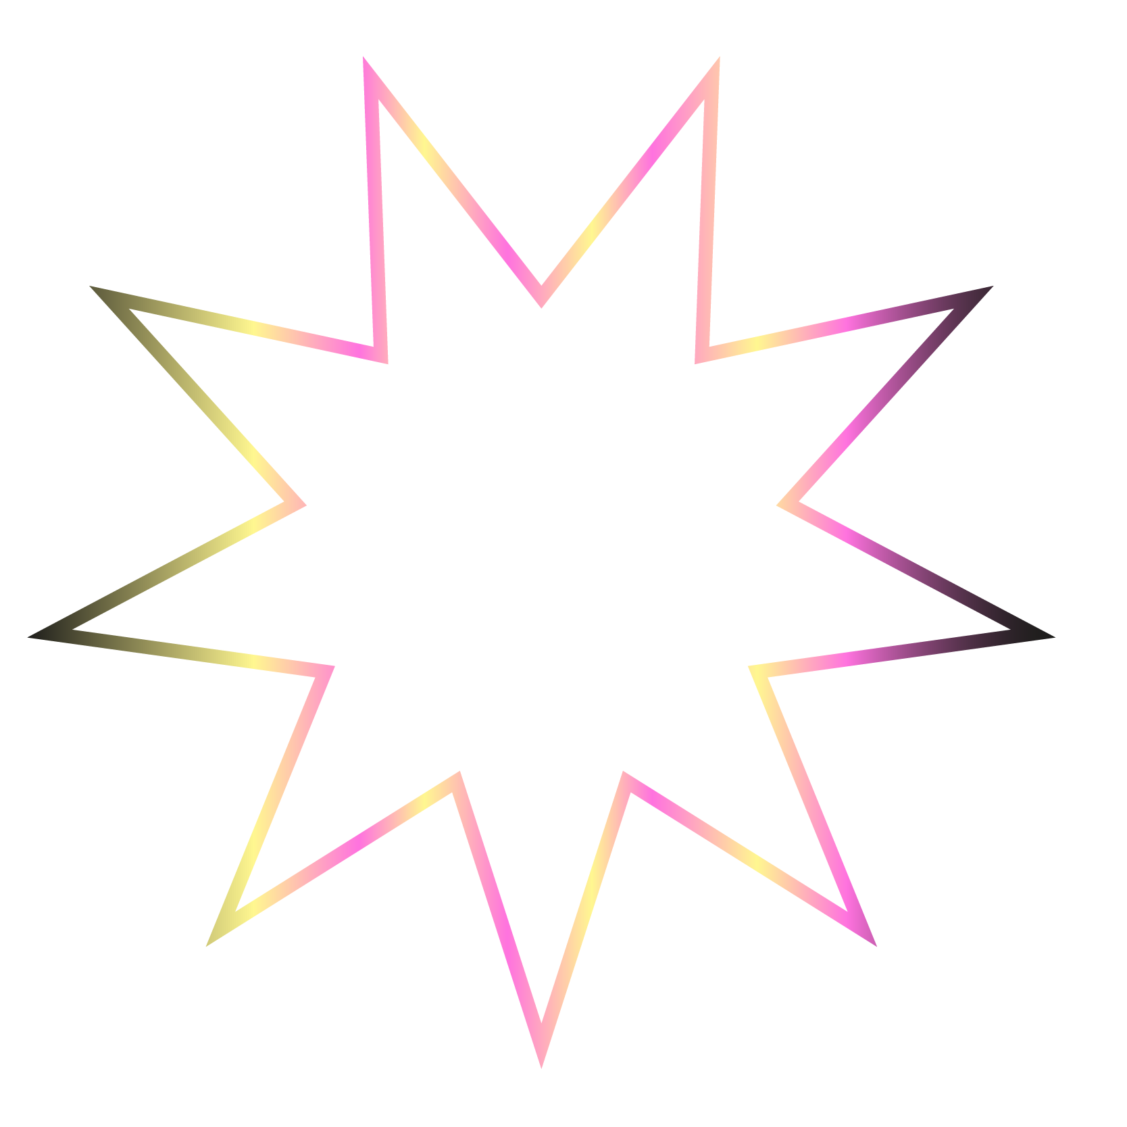

Before we start...
Let’s do a quick check-in activity!
In breakout rooms:
Grab the closest thing to you and try to sell it to your partner.
As a group, one-by-one:
What did you try to sell?
Notes:
Social Time [5 minutes]

Slide 4
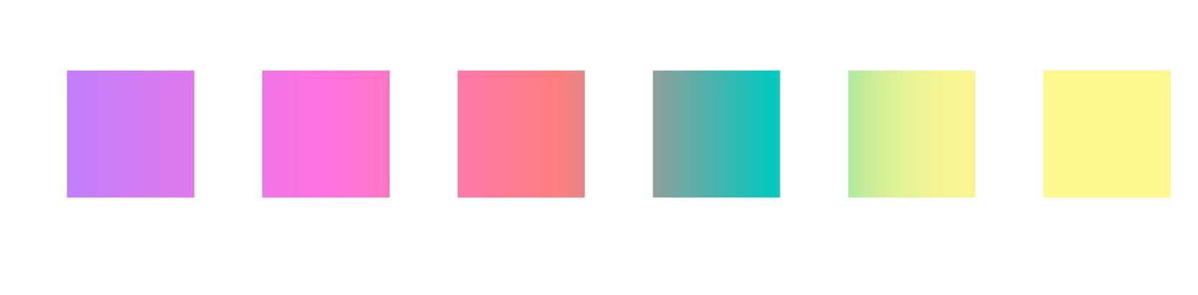
Questions?
Before we jump into the recap, are there any questions?

Slide 5

Lecture Recap
Notes:
Brief conceptual review [3-5 minutes]
For our lecture recap we’re going to break things down into two parts: functions, and graphics.

Slide 6
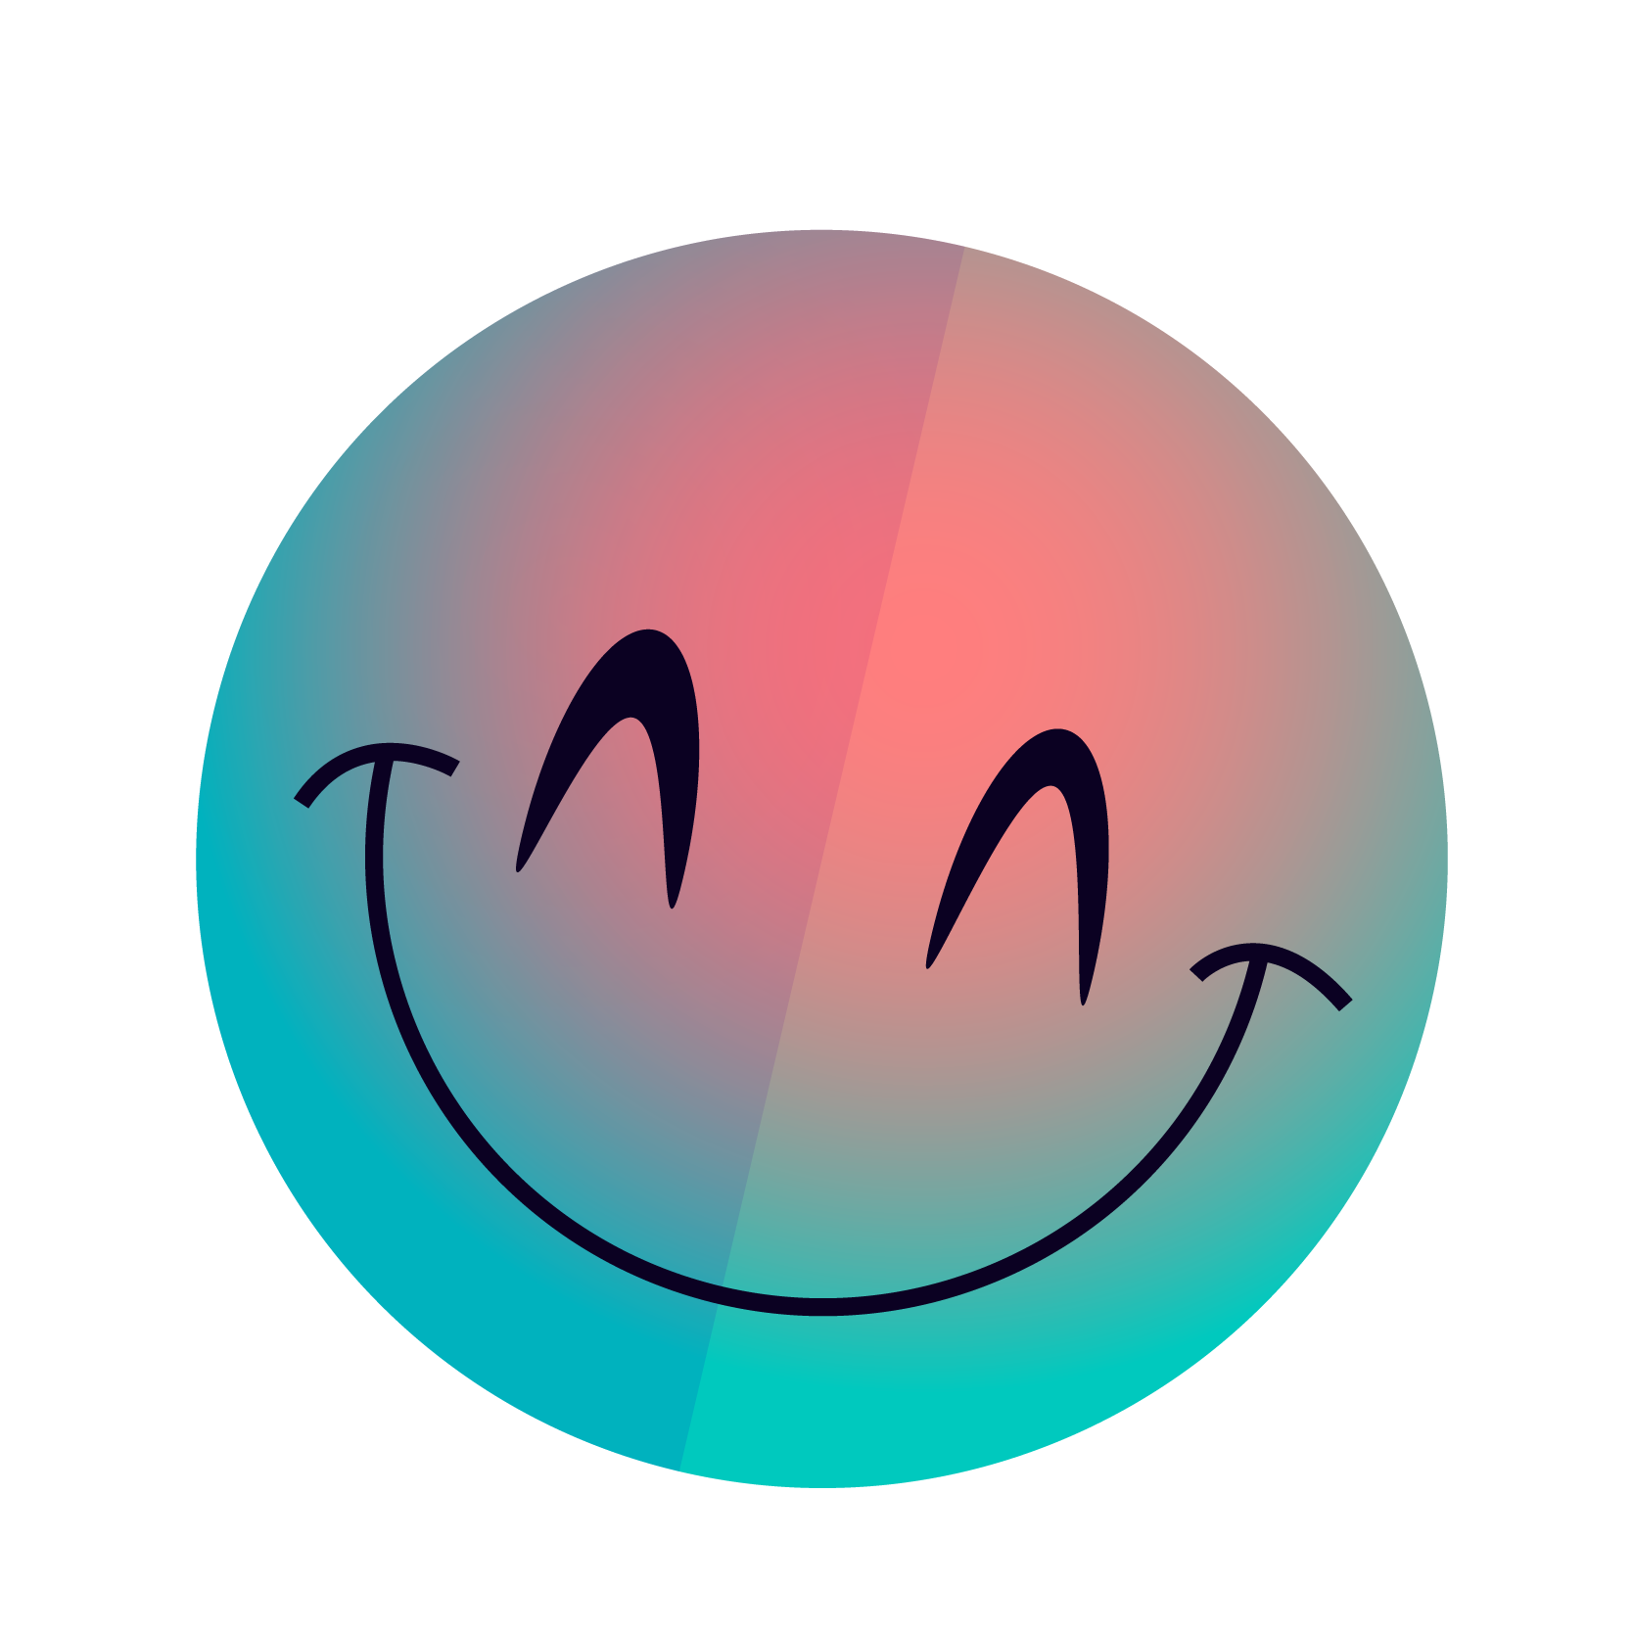

Recap - Functions 2.0
Notes:
We’ll start off with reviewing functions now that we have new knowledge regarding them!

Slide 7
Functions 2.0
Parameters
Incorrect
def function_one():
variable_one = 0
function_two()
def function_two():
variable_two = variable_one
Not possible! function_two doesn’t know that variable_one exists!
Parameters are a way to pass data to your helper functions. Variables made in a function are invisible to other functions unless it is passed through a parameter.
Correct
def function_one():
variable_one = 0
function_two(variable_one)
def function_two(example_param):
variable_two = example_param
We use a parameter to pass the data instead
Notes:
First: parameters. Parameters are a way to pass data to a helper function. When we code, we usually have functions calling other functions, and those other functions may themselves call functions. Variables from one function are hidden from other functions, so we want a way to pass data between functions without re-defining variables all the time. This is where parameters come in! Parameters allow us to pass data from function to function. We define our parameters when we define our functions and we pass the values through the parameters whenever we call said function.

Slide 8
Functions 2.0
Returns
Similar to parameters, but in the reverse direction! We use return statements to pass data from a function to wherever it was called.
One example is the input() function that you’ve been using! Whenever you have a function that returns something, you usually want a variable to store that data!
def function_one():
name = input(“Enter your name: ”)
def input(prompt):
... # Some code
return user_input
input() returns data for you to use, wherever you called it from!
Notes:
Second: returns. Having data passed to a helper function is nice, but sometimes, you want some piece of data back! This is exceptionally true if you are decomposing a step for something like receiving data or doing some math. One example you’ve been unknowingly using is the input function. You pass in a prompt as a parameter, and you get back hopefully the user’s input to the prompt. This is done via a return statement. Generally, if you are returning something, you’ll want a variable to store that data (or else, what was the point in the return?)

Slide 9


Recap - Graphics
Notes:
Moving on to graphics

Slide 10
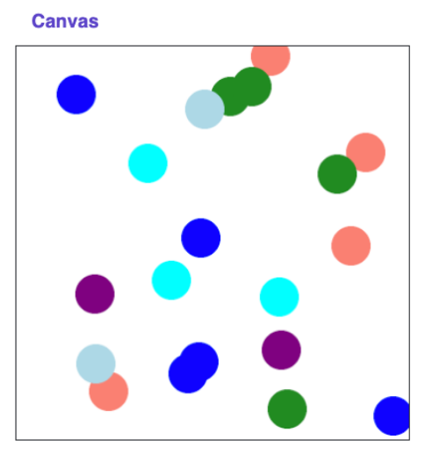
Canvas
The canvas is a fun way for us to visualize and interact with our code in a somewhat similar way to Karel!
Notes:
Remember that when we work with graphics in Code in Place, we will be using a canvas to create things on! It’s a neat way to interact and visualize our code.

Slide 11
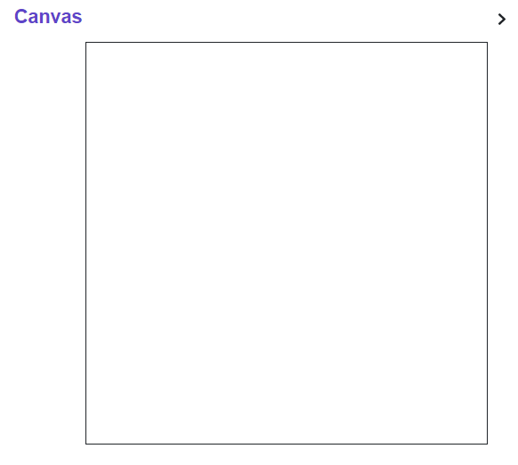
Canvas
(0, 0)
Remember how pixels are laid out: starting at (0, 0) for the top left and increasing in x/y-values as you go right/down respectively
(150, 150)
(300, 300)
Notes:
Some things to remember though are how the canvas is laid out. The top-left corner has coordinates (0, 0) and as we move right, the x-coordinate increases. Likewise if we move down, the y-coordinate increases. This means that the bottom right corner might be something like (300, 300)

Slide 12
Canvas
x1
y1
40px
(0, 0)
To draw something, we need to use four parameters. These numbers represent the coordinates of the two points used to draw the image. Since the function is a part of our canvas, we use our canvas followed by a period and then the function name. We can also add an extra parameter for color if we want.
Example:
canvas.create_rectangle(0, 0, 40, 40, “Purple”)
40px
(40, 40)
x2
y2
(300, 300)
x1
y1
x2
y2
color
Notes:
In terms of drawing, I know there’s a lot of arrows going on, but bear with me for a second! When we draw we need primarily two things which is broken down into four parts. Those two things are a starting point and an ending point for the bounding boxes of our shape. In this example, I’ve made a square that has a side length of 40 pixels. I did so by having a starting point at (0, 0) and an ending point at (40, 40). I also added some color to make it a bit more visible. These two points are required to be broken down into their x and y-components for our function to work with.
There is a key distinction here that we haven’t seen too much which is this idea of having the word canvas followed by a dot and then the function name. This goes into later topics, but it is related to telling Python which canvas we want to draw to, as we may have several different canvases!

Slide 13
Recap Questions
Wow! That was a lot! You’ve also been learning a lot.
Are there any questions over lecture content or anything else?

Slide 14
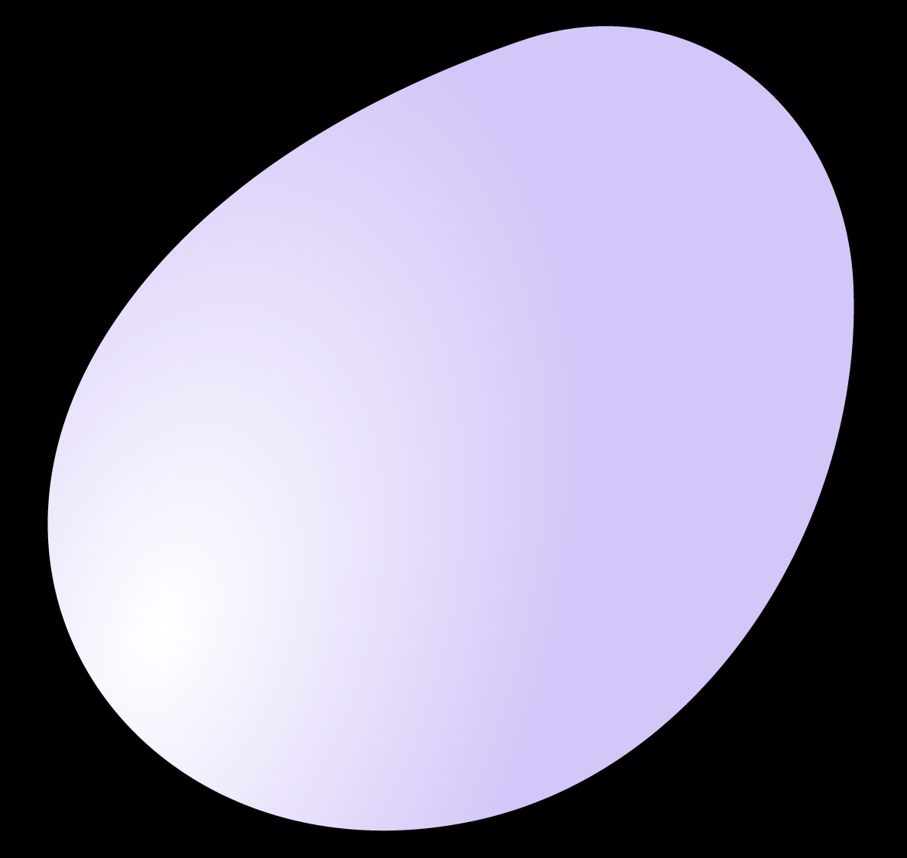
Section Problem: Random Circles
Notes:
Now, let’s get into our section problem!

Slide 15
Random Circles
As an intro to functions & graphics, we want to get comfortable with:
The conceptuals of drawing and indexing with pixels
Calling functions with parameters/returns.
To practice, let’s write a program that draws 20 circles at random positions with random colors on the canvas.
Notes:
To make us more comfortable with functions and graphics, we are going to practice with drawing a whole bunch of circles to the canvas. The difficulty lies primarily with getting the circles to be the right size and right location due to us being new to working with pixels.
Our practice problem is to draw 20 circles to the canvas. The catch is that these circles should be placed at completely random spots, each with a random color.

Slide 16
End Goal
Example Starting Canvas
X20
Our program takes in a blank canvas and then draws 20 circles at random positions with random colors on the canvas.
Example Output Canvas
Notes:
So here, we start with an empty canvas (shown by the top image) and we would draw 20 circles at random to the canvas. The output would look like the canvas on the bottom.

Slide 17
Problem Details
Canvas
Colors
Canvas Details
Circle Details
The canvas is created for you already with some functions provided
We provide a function that returns a random color
Canvas width/height are provided as global variables
We give you the diameter size of the circles and the number of circles to make
Notes:
Some key problem details are:
We already have a canvas made for us
We have a function which provides us a random color already
We are given a specific width and height as global variables for usage
We have details regarding the size and number of circles we need to make.

Slide 18
Pre-code Discussion
Say we want to make a single circle, how would we do that?
Hi, I’m a
circle! And
single!
Are there any questions regarding the canvas, graphics, drawing, or anything else?
Notes:
Before we begin coding things up, conceptually what might making just a singular circle look like? Say we wanted to make a circle in the top left corner, how would we do that? What about the bottom right? Do we see a pattern?
Lastly, are there any questions over what we covered or something else?

Slide 19
Coding Time!
Let’s split into breakout rooms to code up the solution!
Notes:
Now that we’re comfortable with the problem, let’s break out into groups to wrap up the problem!

Slide 20
Post-code Discussion
Are there any questions at all?
Notes:
Before we begin coding things up, conceptually what might making just a singular circle look like? Say we wanted to make a circle in the top left corner, how would we do that? What about the bottom right? Do we see a pattern?
Lastly, are there any questions over what we covered or something else?

Slide 21
Extensions
Number of Circles
Size of Circles
Bounds of Circles
x
✔
#
Create a random amount of circles instead of a set amount!
Have the circles be of random size instead of a set size!
Make sure all circles are in the bounds of the canvas!

